Slide 1
Building a datapath
“The component of the processor that performs arithmetic operations.”

Slide 2
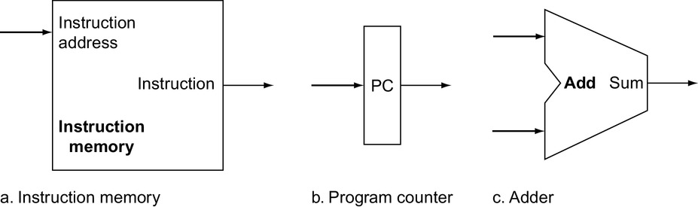
Datapath
A unit used to operate on or hold data within a processor. In the MIPS implementation, the datapath elements include the instruction and data memories, the register file, the ALU, and adders.

Slide 3
Components of the MIPS architecture
Memory
Other components of the datapath
Control unit

Slide 4
In MIPS, programs are separated from data in memory
Text segment
“instruction memory”
part of memory that stores the program (machine code)
read only
Data segment
“data memory”
part of memory that stores data manipulated by program
read/write

Slide 5
For reading/writing the data segment
Memory address computed as base+offset:
base is obtained from a register
offset is given directly as an integer
Load word (read word from memory into register):
lw $t1,8($t2) ⇒ $t1 := Memory[$t2+8]
Store word (write word from register into memory):
sw $t1,4($t2) ⇒ Memory[$t2+4] := $t1

Slide 6
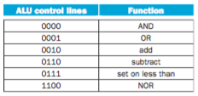
A simple implementation scheme
The ALU control

Slide 7
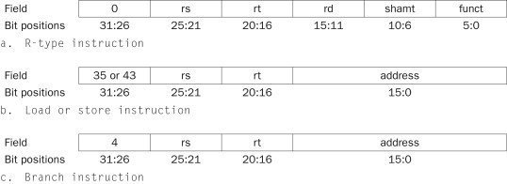
For the R-type instructions, the ALU needs to perform one of the five actions (AND, OR, subtract, add, or set on less than), depending on the value of the 6-bit funct (or function)

Slide 8
The format
There are several major observations about this instruction format that we will rely on:
The op field is called the opcode, is always contained in bits 31:26. We will refer to this field as Op[5:0].
The two registers to be read are always specified by the rs and rt fields, at positions 25:21 and 20:16. This is true for the R-type instructions, branch equal, and store.
The base register for load and store instructions is always in bit positions 25:21 (rs).
The 16-bit offset for branch equal, load, and store is always in positions 15:0.
The destination register is in one of two places. For a load it is in bit positions 20:16 (rt), while for an R-type instruction it is in bit positions 15:11 (rd). Thus, we will need to add a multiplexor to select which field of the instruction is used to indicate the register number to be written.

